Slide 1





Chewy
GDPR compliance and Data Loss Prevention Project
MID GROUP PROJECT: 401n2
Cyberia Security .

Slide 2
AGENDA
1. Team member Introductions
2. Problem Domain & Project Overview
3. Application Demonstration
4. Documentation
5. Q&A

Slide 3
Team Members Introduction
OUR TEAM

Slide 4

Diogo Figueiredo
“I try every day to become a better version of myself.
I believe that my diverse background in biology and hospitality will make a huge contribution to my aspiring cybersecurity career.”

Slide 5

Hélio Ferreira
"I am a cybersecurity enthusiast who's guided by the values of professionalism and good faith. With a background in accounting and insurance, I hope in the future I can use that knowledge in multiple Cybersecurity areas."

Slide 6

Tomás Ferreira
“I specialize in cloud cybersecurity.
I am fascinated about understanding how hackers think and operate.
I believe that by studying their techniques, we can develop more effective defenses.”

Slide 7
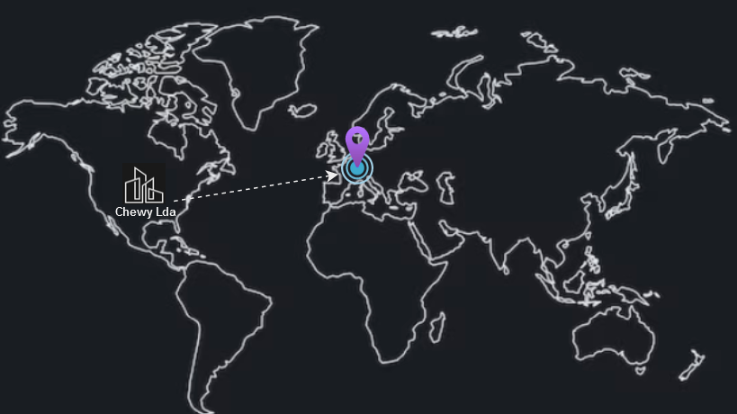
Problem Domain
Chewy’s Strategy
Problem
Sales growth in International markets
Europe GDPR compliance
Protect PCI/PII Data

Slide 8

PROJECT OVERVIEW
Proper IAM Implementation
-Create individual IAM users for each team member.
-Assign least-privilege permissions to users based on their roles.
-Enable MFA for all users with high-level access.
-Regularly review and audit IAM policies and access logs.

Slide 9
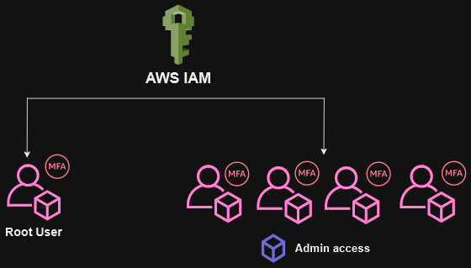
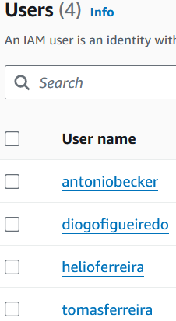
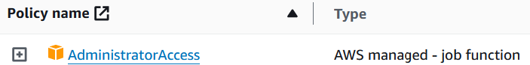
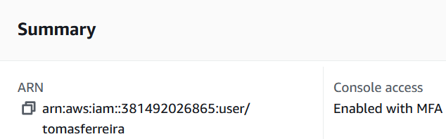
IAM Implementation
1.
2.
3.

Slide 10
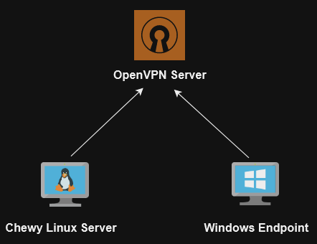
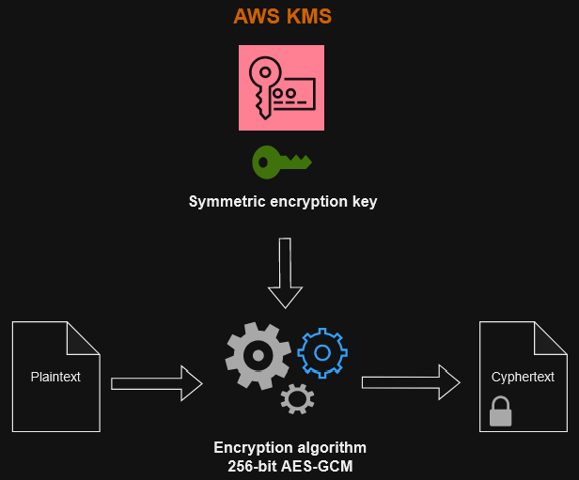


CIS Compliant Data Server
-Launch a Linux EC2 instance and configure it according to CIS benchmarks.
-Use AWS KMS to manage encryption keys and encrypt EBS volumes attached to the instance.

Slide 11
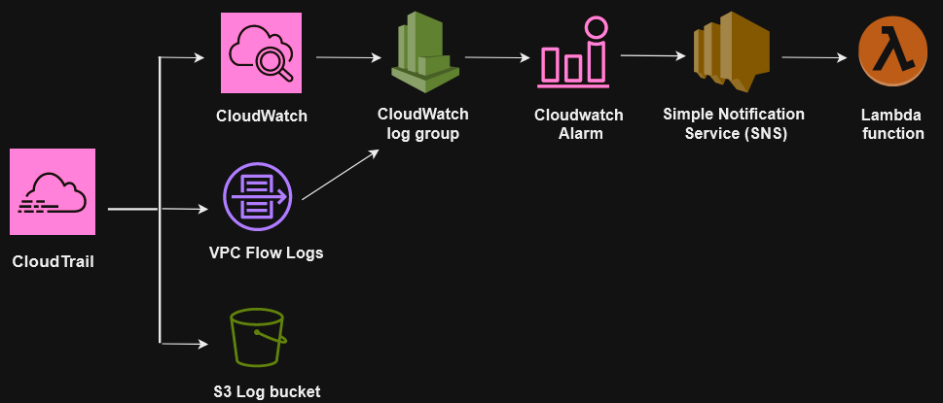
SIEM/Log Aggregation System
-Set up the chosen SIEM tool and integrate it with AWS services.
-Configure CloudTrail, CloudWatch Logs, and VPC Flow Logs.
-Set up notification channels (SMS or email) to alert administrators.

Slide 12
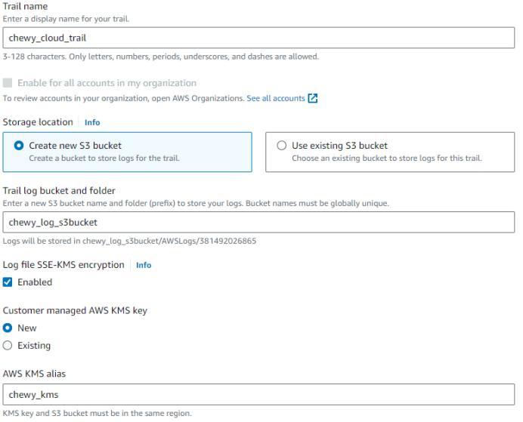

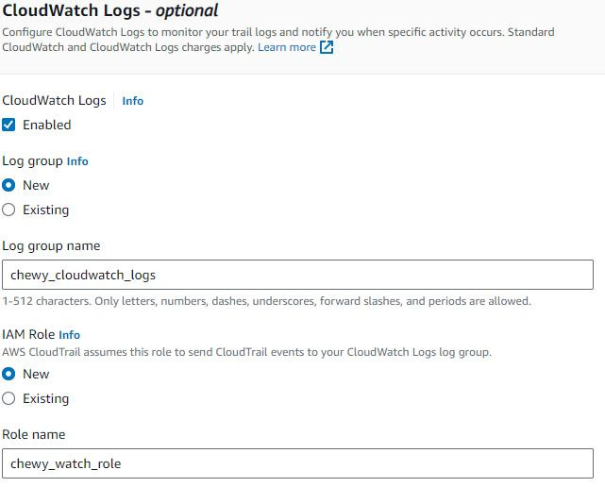

SIEM/Log aggregation system
Configure CloudTrail
2. Configure CloudWatch

Slide 13
Cloud Monitoring
-Enable VPC Flow Logs for the VPCs containing sensitive data.
-Set up CloudWatch Alarms based on specified metrics.
-Configure an action to execute a response to the threat

Slide 14
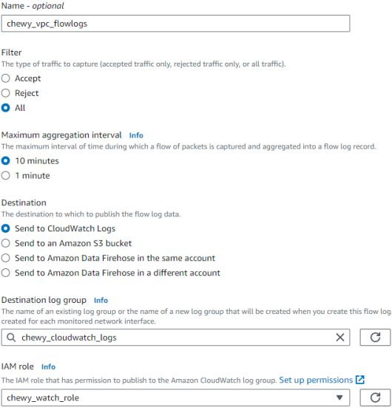

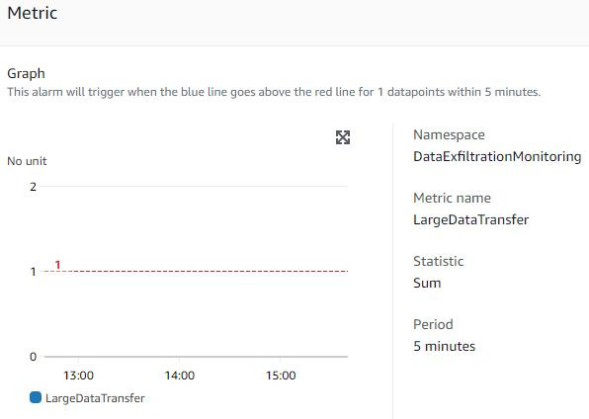
3. Create VPC Flow logs
4. Add Data Exfiltration Metric

Slide 15
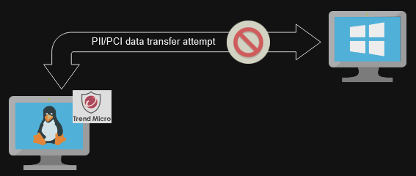
Data Loss Prevention (DLP) Controls
-Select a DLP solution compatible with AWS [Trend Micro].
-Configure policies to detect and prevent the transfer of PII and PCI data.
-Test the DLP solution to ensure it effectively blocks unauthorized data exfiltration.

Slide 16
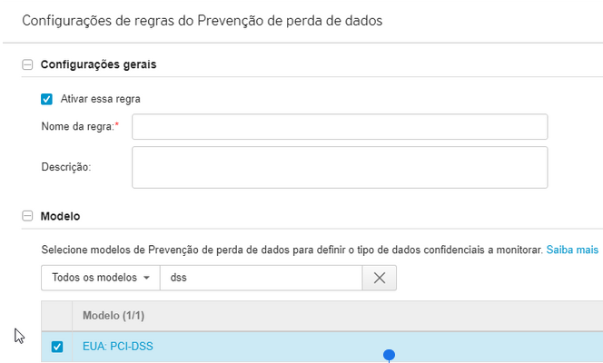
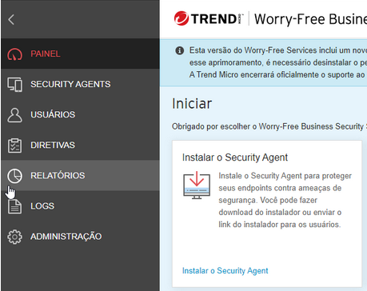
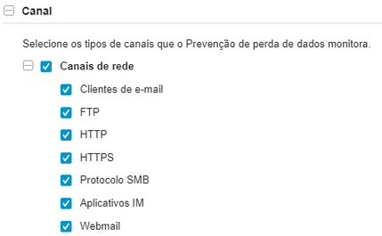
DLP tool
1. Create Trend Micro account
3. Policy configuration
2. Trend Micro installation

Slide 17


DOCUMENTATION
Report
Project Repo

Slide 18
APPLICATION & DEMONSTRATION
DEMO

Slide 19
THANK YOU

